Slide 1


SAP S/4HANA CDS, RAP Training Day 12
Anubhav Oberoy

Slide 2

Agenda – Day 12
Enable Early Numbering for Travel and Booking
Integrating augment in Managed Object
--Break
Understand the persona for Approver
Implementing Approver projection
Annotations for Approver Scenario
Behavior Definition for Approver
Service Binding for Approver Scenario
Fiori App for Approver
--Break
Git and GitHUB
Deployment to S/4HANA
Integrate with Launchpad
Notes:
https://unsplash.com/photos/CPs2X8JYmS8

Slide 3

Enable Early Numbering for Travel and Booking
About Numbering
Numbering is about setting values for primary key fields of entity instances during runtime.
The primary key of a business object entity can be composed of one or more key fields, which are identified by the keyword key in the underlying CDS view of the business object. The set of primary key fields uniquely identify each instance of a business object. The primary key value of a business object instance cannot be changed after the CREATE.
There are various options to handle the numbering for primary key fields depending on when (early or late during the transactional processing) and by whom (consumer, application developer, or framework) the primary key values are set. You can assign a numbering type for each primary key field separately.
Early and Late Numbering
In an early numbering scenario, the primary key value is set instantly after the modify request for the CREATE is executed. The key values can be passed externally by the consumer or can be set internally by the framework or an implementation of the FOR NUMBERING method. For more information, see Early Numbering.
In a late numbering scenario, the key values are always assigned internally without consumer interaction after the point of no return in the interaction phase has passed, and the SAVE sequence is triggered. This ensures a gap free key value assignment like it is required for example for invoices. For more information, see Late Numbering.

Slide 4
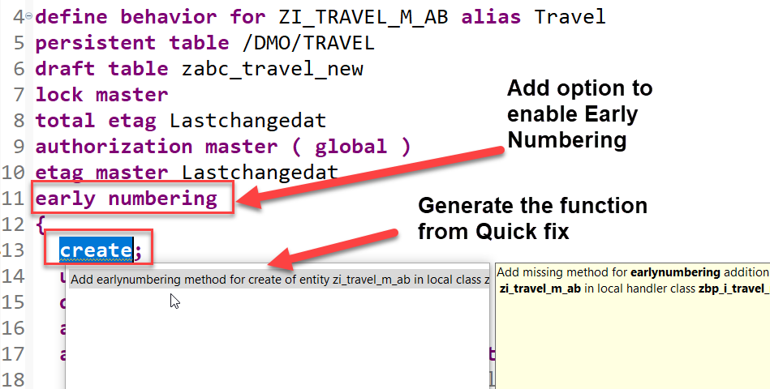
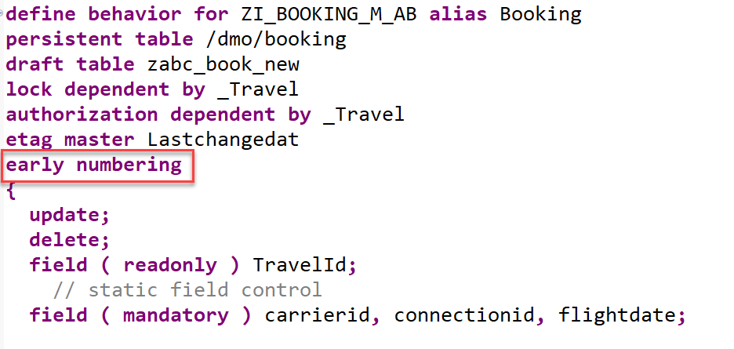
Implementation for Early Numbering
Add the addition early numbering keyword as shown below to enable early numbering for your travel entity.
The ADT Quick Fix feature can be used to add the earlynumbering method for travel entity.
Implement the function to handle early numbering – code here
Repeat the same for the booking by adding early numbering
Implement the function to handle early numbering – code here

Slide 5
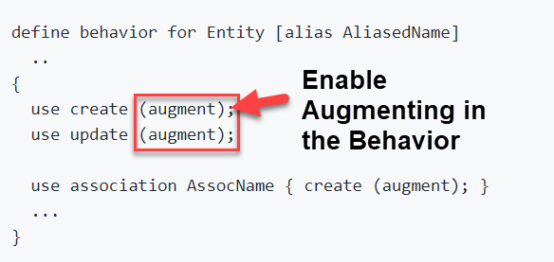
What is Augmenting
With an augmentation implementation you can add data or modify incoming requests on the projection layer before data reaches the transactional buffer. You can add data to a modify request or issue additional requests by augmenting the operation before the request is passed to the base business object.
Use case
• Defaulting for incoming requests.
• Behavior-enabling denormalized fields, for example enabling editing of language dependent fields.
Definition
Augmentation is defined in the projection behavior definition on the relevant operation with the following syntax:

Slide 6
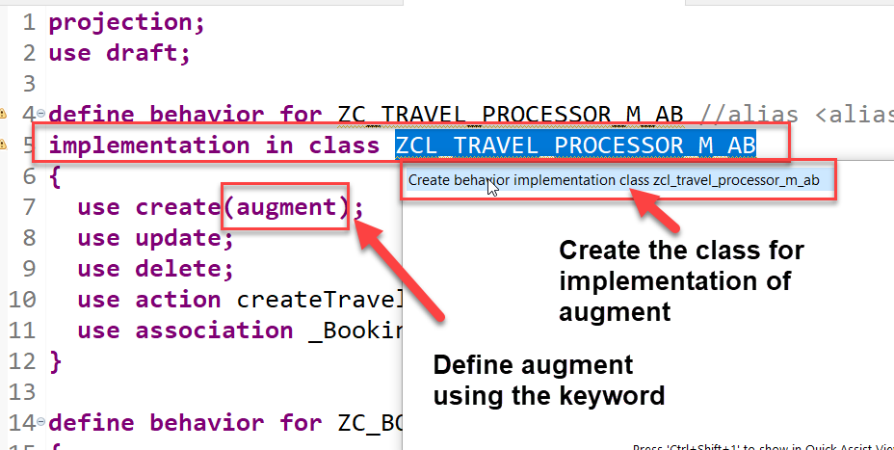
Use case and Implementation
We want to auto populate the agency id and the status of a new travel request during creation. The business has already provided default values which needs to be made available on fiori app.
Process
In our projection behavior definition, define augmentation for the create operation.
Add behavior implementation class to the Travel behavior.
The ADT Quick Fix feature can be used to create implementation class for travel entity.
Write the code to implement the default values for the agency id and status- Code here

Slide 7


Understand the Persona for Approver
The business object projection is the basis for a UI service that contains the functionality that is relevant for an approver. Imagine a person, maybe a manager of a travel agency, that approves the data that was entered by the processor. That means, this person sees the travel information and the corresponding booking data. Based on this data, the approver can either accept or reject the travel. For a minimal scope of fields in the travel entity the approver is enabled to edit the values, for example the BookingFee or the Description. The information about bookings is set to read-only for the approver. The approver is not allowed to change the fields of the booking entity.
Approver
Accept
Reject

Slide 8
Approver Scenario
Travel Projection CDS View for Approver BO
Except for the actions, which are different in the processor and the approver projection, the CDS projection views for the processor and the approver BO are identical. Minor changes can be detected in the field label of the field TravelID and TravelStatus. This results from the fact, that the approver does not create new travel entries. It is not necessary for this role to know the number range of the TravelID or the possible values of the TravelStatus. In addition, the approver BO projection has gained a selection field for the TravelStatus to make it easier for the approver to filter for open/accepted/rejected travels.
Actions
The position and the label for the action button must be defined in the CDS projection views. In the case of an approver, the available actions concerning the travel entity set are Accept Travel and Reject Travel. The implementation of these actions is done in the behavior implementation . It is simply the UI appearance that needs to be configured in the projection view. The action buttons for the respective actions are designed to appear on the travel list report page and on the travel object page. That is why the annotations are used in the list item and identification UI annotation. When executing the action on the list report page, a travel instance must be selected to assign an instance for the instance-bound action. On the object page, the instance for which the action shall be executed is clear.
Booking Projection CDS View for Approver BO
The CDS projection views for the processor and the approver BO are almost identical.
Value helps are not necessary for the interpretation of the approver role in this scenario. As the booking entity is a read-only entity in this scenario and selection fields with value helps cannot be defined for a sub entity, value helps cannot be applied and thus are not necessary to be defined for the booking entity.

Slide 9
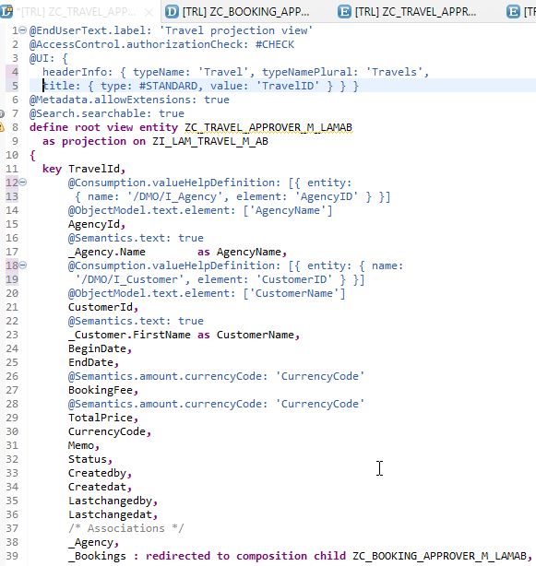
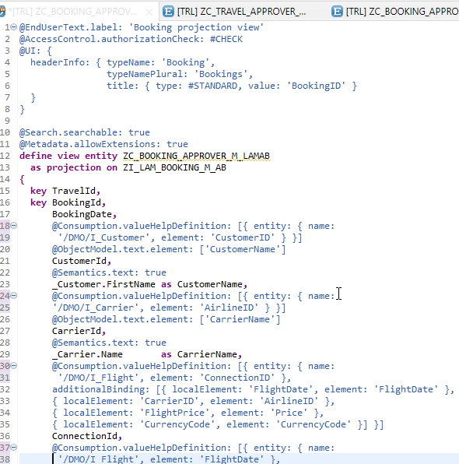
Implementing Approver Projection CDS
ZC_TRAVEL_APPROVER_M_LAMAB
ZC_BOOKING_APPROVER_M_LAMAB

Slide 10
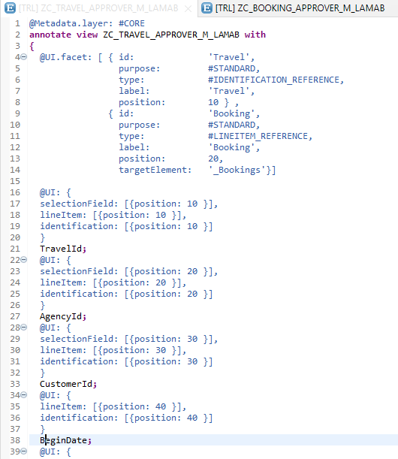
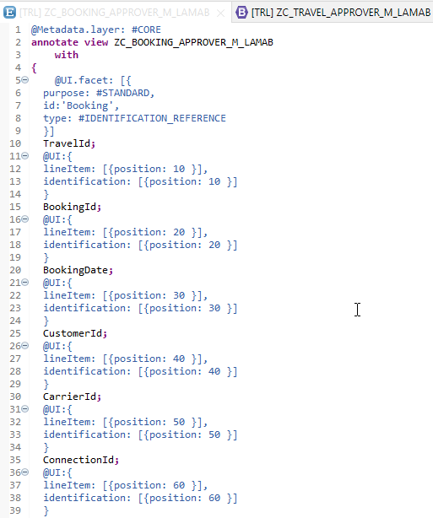
Metadata Extension
Metadata Extension for Travel
Metadata Extension for Booking

Slide 11
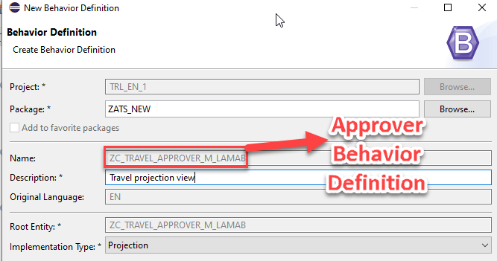
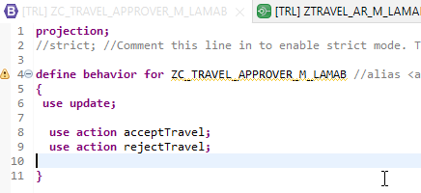
Behavior Definition for Approver
The scope of the UI service for the approver is more limited than for the processor. The approver can only modify the travel entity with accepting or rejecting the travel entries. The values in the corresponding booking entries are the basis for this decision-making.
The behavior for the BO projection is defined in a behavior definition of type projection. The type is defined in the behavior definition header. The projection behavior definition provides the behavior for the projection CDS view. All characteristics and operations that you want to include in the BO projection must be listed explicitly. The keyword for this is use. - Code here

Slide 12
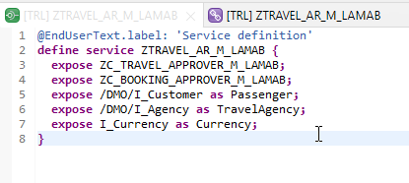
Service Definition
The service definition is a projection of the models and related behavior that you want to expose.
In a service definition, you define the OData service to determine which CDS entities are part of the service. This service is then bound to a protocol and to either a UI technology or an A2X service by a service binding artifact. A service definition can be integrated in various protocols without any reimplementation.
Service definition is used to assign the scope of the OData service. Travel, Booking, Passenger, TravelAgency, Currency CDS views are exposed in the service definition. Optionally, you can assign an alias for the each exposed CDS view
Exercise
Service Definition

Slide 13
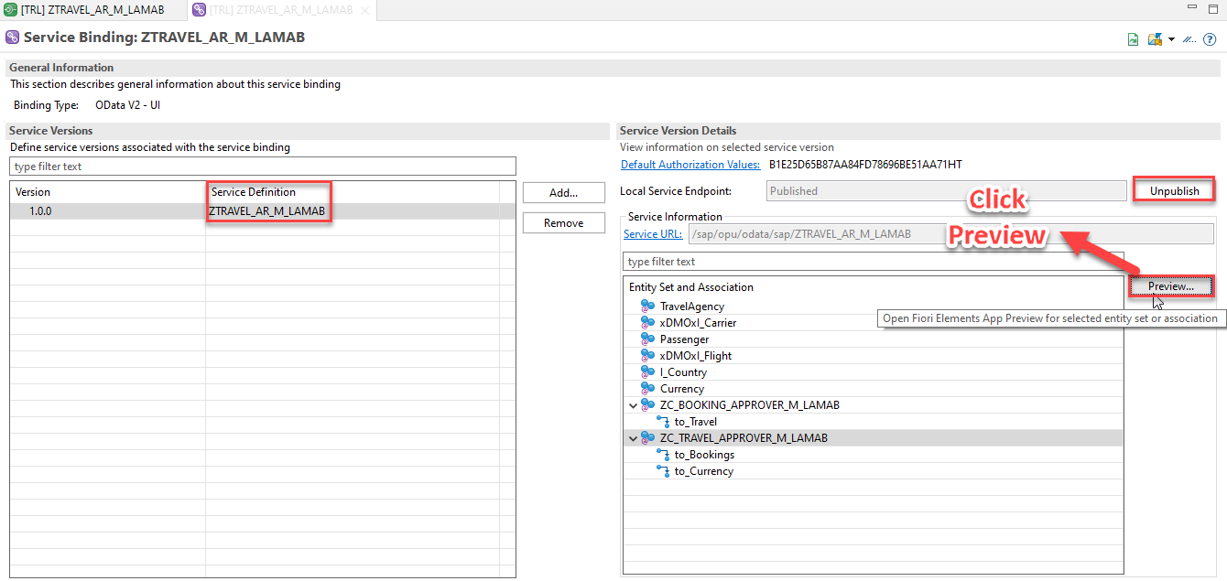
Service Binding
A service binding implements the protocol that is used for the OData service. It uses a service definition that projects the data models and their related behaviors to the service.

Slide 14
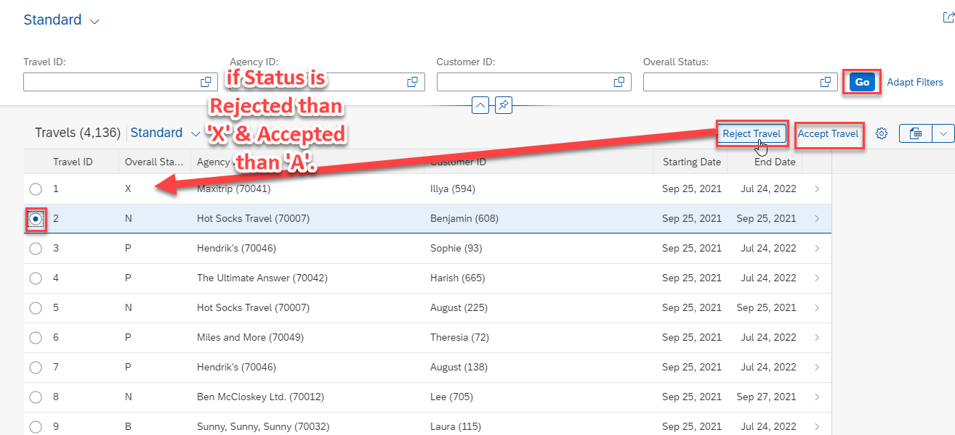
Fiori App Preview

Slide 15

Challenges to share code
Till now Anubhav is sharing zip file of project code with all of you, imagine in a team of 40 developers and at end of day if every developer share a zip file, who can merge all code.
When someone go on holiday or left team, how can we make sure that we have latest code available for successor to manage it.
Anubhav last evening my code was stable, this morning I came to office and made 40-50 changes which has disrupted everything, I pray to god to go back to last night state. Basically, we need version management.
In a team, one developer using BAS another using VS code another using WebIDE, how can we easily move code from one dev tool to another
When something cause production issues, we want to know which change was made by who last time that caused the issue.
How to share our code effectively between multiple team members as best practice from industry. And how to merge conflicts also.
Git and Github
Git is a de-central repository management system for managing any kind of source code. And git hub is a central repository where everyone sync their changes (internet).
https://git-scm.com/download/win
www.anubhavtrainings.com

Slide 16


Ryan – UI5 developer
git init
Create .gitignore
git add .
git commit -m “msg”
MAKE Changes
git reset --hard
Local Repository
Project (ui5)
VS Code
git pull
git branch -M master
git remote add origin https://github.com/soyuztechnologies/Test_Ryan_ui5_project.git
git push -u origin master
gitHUB
Rob – UI5 developer
BAS
git clone URL
git pull
www.anubhavtrainings.com

Slide 17
Title
Text

Slide 18
Title
Text

Slide 19

Questions?

Slide 20

Thank you
Anubhav.abap@gmail.com
contact@anubhavtrainings.com
+91 84484 54549
www.anubhavtrainings.com

